Slide 1
Information Systems,
Tenth Edition
Chapter 3
Hardware: Input, Processing, and
Output Devices

Slide 2
Principles and Learning Objectives
Computer hardware must be carefully selected to meet the evolving needs of the organization and of its supporting information systems
  Describe the role of the central processing unit and main memory
  State the advantages of multiprocessing and parallel computing systems, and provide examples of the types of problems they address
Information Systems, Tenth Edition

Slide 3
Principles and Learning Objectives (continued)
  Describe the access methods, capacity, and portability of various secondary storage devices
  Identify and discuss the speed, functionality, and importance of various input and output devices
  Identify the characteristics of and discuss the usage of various classes of single-user and multiuser computer systems
Information Systems, Tenth Edition

Slide 4
Principles and Learning Objectives (continued)
The computer hardware industry is rapidly changing and highly competitive, creating an environment ripe for technological breakthroughs
  Describe Moore’s Law and discuss its implications for future computer hardware developments
  Give an example of recent innovations in computer CPU chips, memory devices, and input/output devices
Information Systems, Tenth Edition

Slide 5
Principles and Learning Objectives (continued)
The computer hardware industry and users are implementing green computing designs and products
  Define the term green computing and identify the primary goals of this program
  Identify several benefits of green computing initiatives that have been broadly adopted
Information Systems, Tenth Edition

Slide 6
Computer Systems: Integrating the Power of Technology
Hardware components:
  Central processing unit (CPU):
  Arithmetic/logic unit (ALU):
  Control unit :
  Registers:
  Primary storage:
Information Systems, Tenth Edition

Slide 7
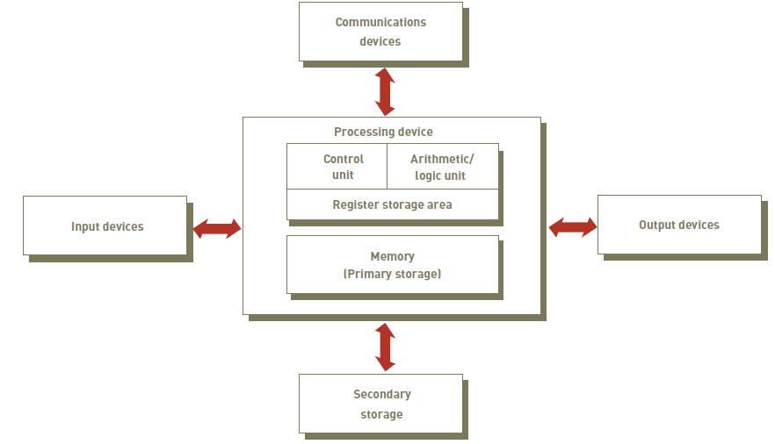
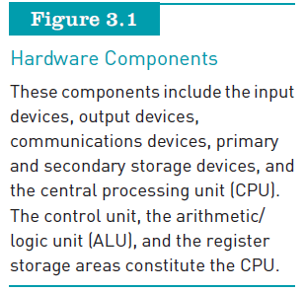
Computer Systems: Integrating the Power of Technology (continued)
Information Systems, Tenth Edition

Slide 8
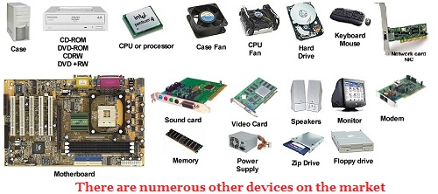

Information Systems, Tenth Edition

Slide 9
Processing Characteristics and Functions (continued)
Physical characteristics of the CPU:
  Most CPUs are:
    Collections of digital circuits imprinted on silicon wafers, or chips, each no bigger than the tip of a pencil eraser
  Moore’s Law:
    Hypothesis stating that transistor densities on a single chip will double every two years
Information Systems, Tenth Edition

Slide 10
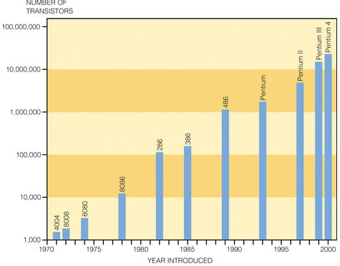

Information Systems, Tenth Edition

Slide 11
Memory Characteristics and Functions
Main memory
  Provides the CPU with a working storage area for programs and data
Storage capacity
  Eight bits together form a byte (B)
Information Systems, Tenth Edition

Slide 12
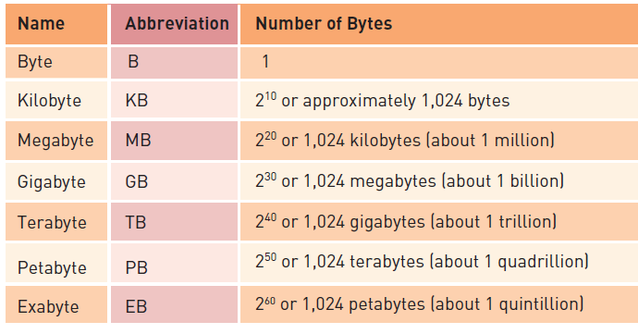

Memory Characteristics and Functions (continued)
Information Systems, Tenth Edition

Slide 13
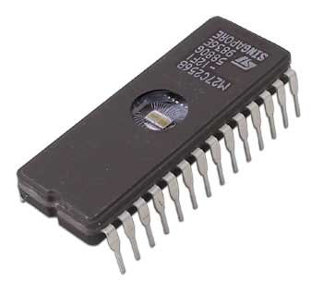
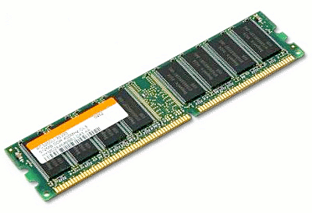
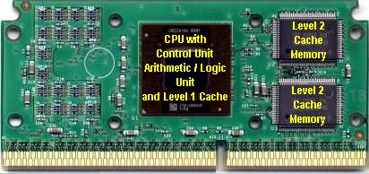
Memory Characteristics and Functions (continued)
Types of memory:
  Random access memory (RAM):
  Read-only memory (ROM):
  Cache memory:
Information Systems, Tenth Edition

Slide 14
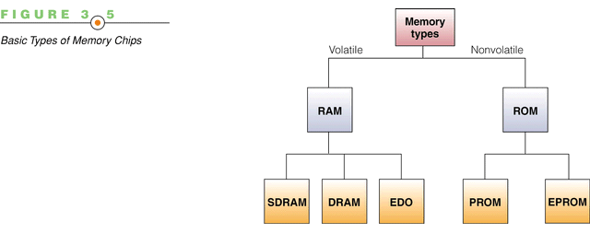
Information Systems, Tenth Edition

Slide 15
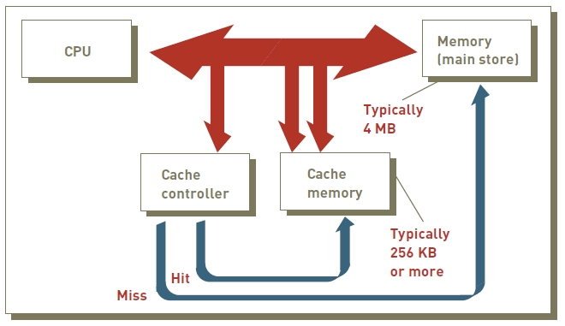
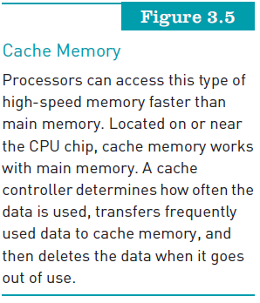
Memory Characteristics and Functions (continued)
Information Systems, Tenth Edition

Slide 16
Multiprocessing
Multiprocessing:
  Simultaneous execution of two or more instructions at the same time
Coprocessor:
  Speeds processing
Multicore microprocessor:
  Combines two or more independent processors into a single computer
Graphics processing unit (GPU):
  A specialized processor that offloads the tasks associated with 3D graphics rendering from the CPU
Information Systems, Tenth Edition

Slide 17
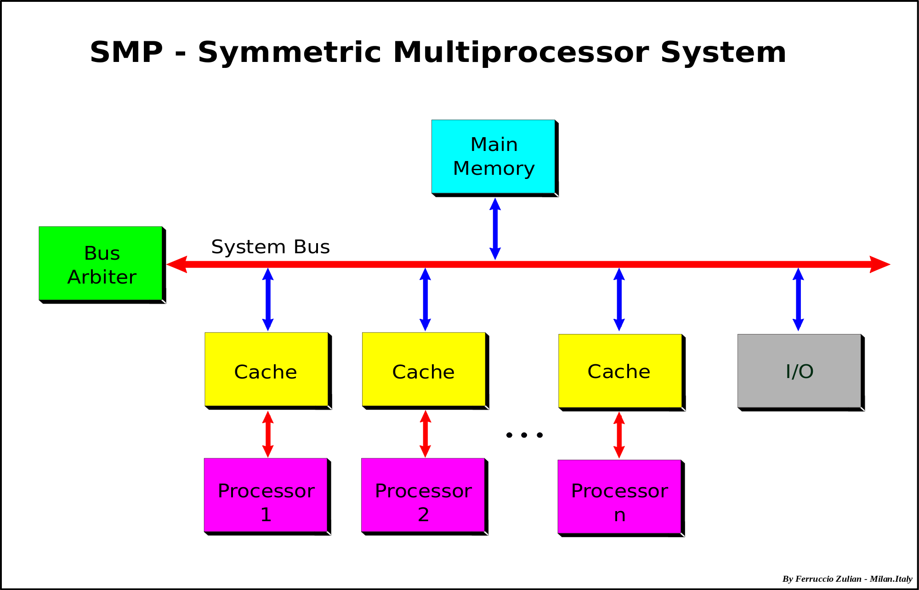
Information Systems, Tenth Edition

Slide 18
Parallel Computing
Parallel computing:
  Simultaneous execution of the same task on multiple processors to obtain results faster
Massively parallel processing:
  Links hundreds or thousands of processors to operate at the same time
Grid computing:
  Use of a collection of computers to work in a coordinated manner to solve a common problem
Information Systems, Tenth Edition

Slide 19
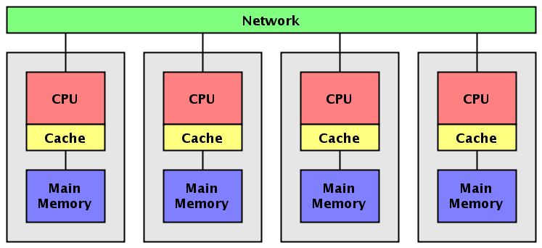
Information Systems, Tenth Edition

Slide 20
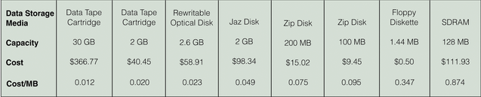
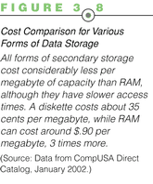
Secondary Storage
Determined by the information system’s objectives:
  The access methods, storage capacities, and portability required of secondary storage media
Information Systems, Tenth Edition

Slide 21
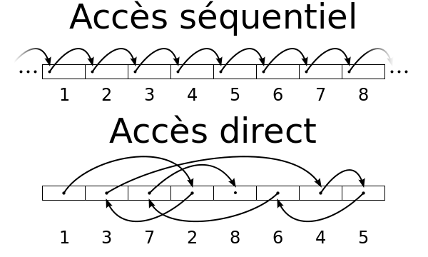
Access Methods
Sequential access vs direct access:
Information Systems, Tenth Edition

Slide 22
Secondary Storage Devices
Magnetic tapes:
Magnetic disks:
Redundant array of independent/inexpensive disks (RAID):
Virtual tape:
Information Systems, Tenth Edition

Slide 23
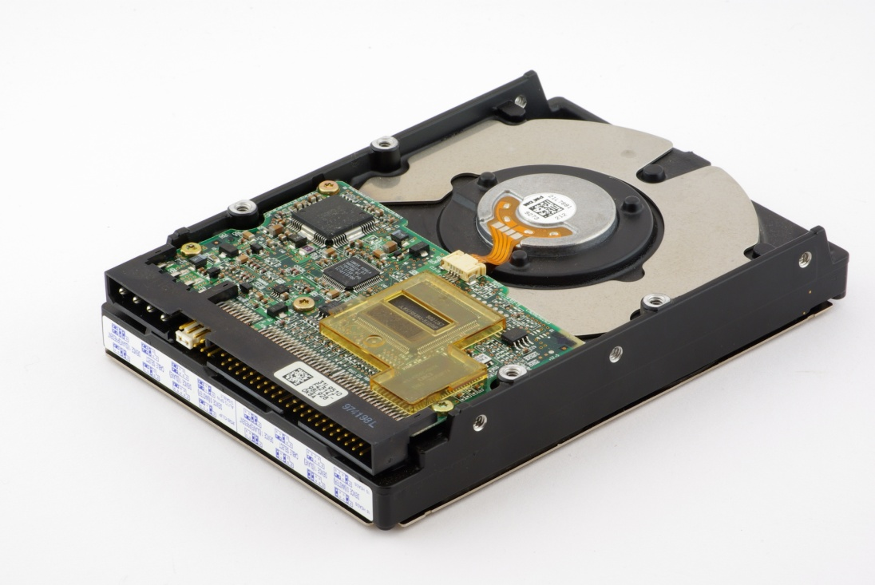
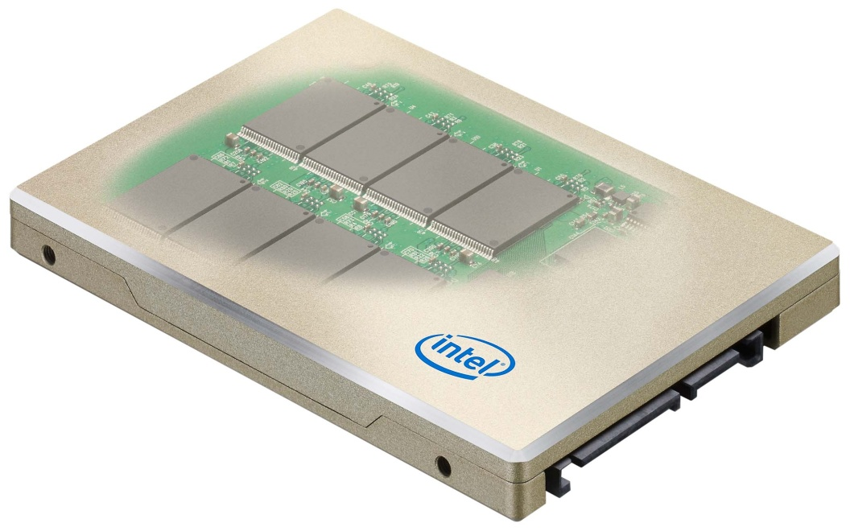
Secondary Storage Devices (continued)
Optical secondary storage devices:
Solid state secondary storage devices:
Information Systems, Tenth Edition

Slide 24
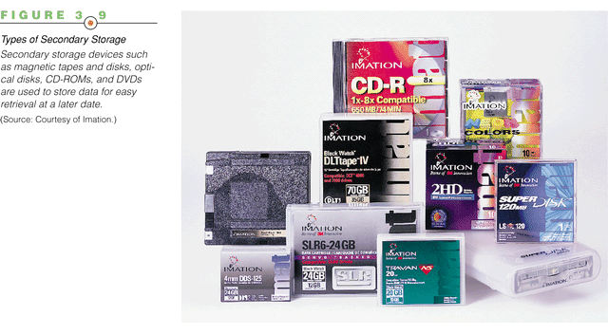
Information Systems, Tenth Edition

Slide 25
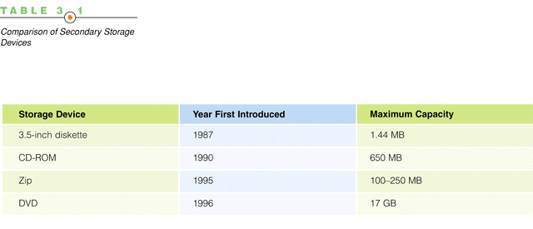
Bluray?
Information Systems, Tenth Edition

Slide 26
Enterprise Storage Options
Attached storage:
  Methods include the tape, hard disks, and optical devices
Network-attached storage (NAS):
  Hard disk storage that is set up with its own network address rather than being attached to a computer
Storage area network (SAN):
  Special-purpose, high-speed network that provides direct connections among data-storage devices and computers
Information Systems, Tenth Edition

Slide 27
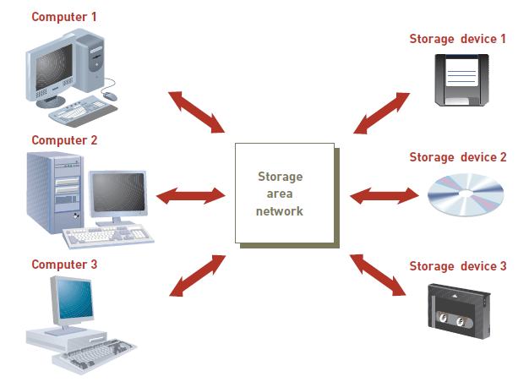
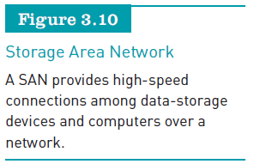
Enterprise Storage Options (continued)
Information Systems, Tenth Edition

Slide 28
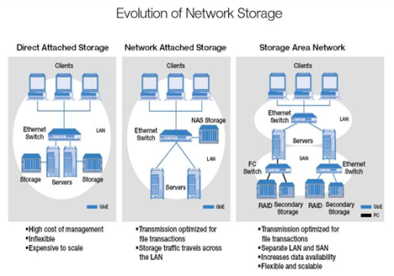
Information Systems, Tenth Edition

Slide 29
Enterprise Storage Options (continued)
Storage as a service:
  A data storage model where a data storage service provider rents space to people and organizations
  Providers:
    AT&T, Aviva, Amazon.com
    EMC, Google, Microsoft, and ParaScale
Information Systems, Tenth Edition

Slide 30
Input and Output Devices: The Gateway to Computer Systems
Input and output devices:
  Gateways to the computer system
  Part of a computer’s user interface
Organizations:
  Should keep their business goals in mind when selecting input and output devices
Information Systems, Tenth Edition

Slide 31
Input Devices
Devices used to input general types of data:
  Personal computer input devices
  Speech recognition technology
  Digital cameras
  Terminals
  Scanning devices
  Optical data readers
  Magnetic ink character recognition (MICR) devices
  Magnetic stripe card
Information Systems, Tenth Edition

Slide 32
Input Devices (continued)
Devices used to input general types of data (continued):
  Chip-and-PIN cards
  Point-of-sale devices
  Contactless cards
  Automated teller machine (ATM) devices
  Pen input devices
  Touch-sensitive screens
  Bar-code scanners
  Radio frequency identification
Information Systems, Tenth Edition

Slide 33
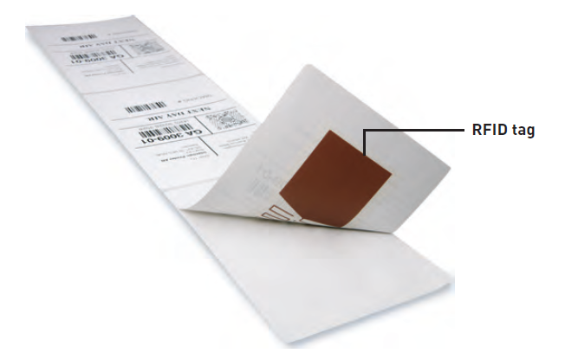
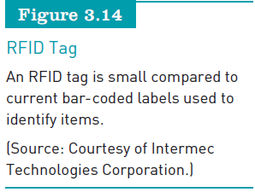
Input Devices (continued)
Information Systems, Tenth Edition

Slide 34
Output Devices
Display monitors:
Plasma display:
LCD displays:
Digital audio player:
Organic light-emitting diodes (OLEDs):
Printers and plotters:
E-books:
Information Systems, Tenth Edition

Slide 35
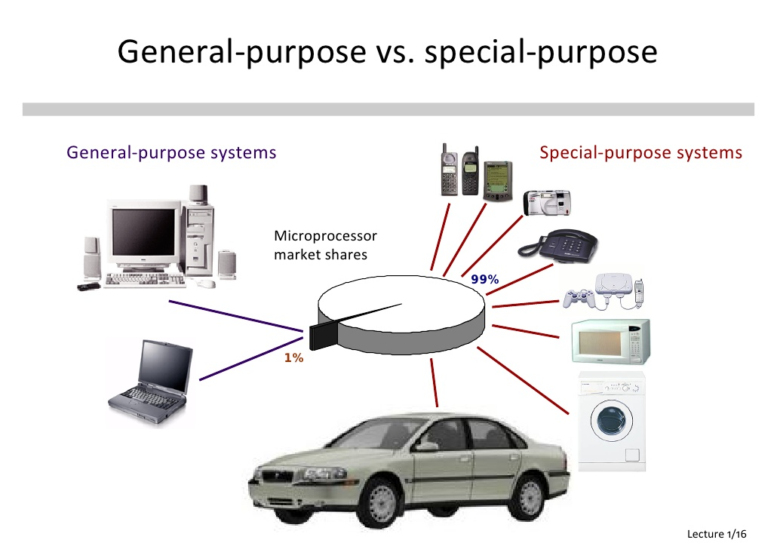
Computer System Types
Special-purpose computers vs General-purpose computers
Information Systems, Tenth Edition

Slide 36
Portable Computers
Handheld computers:
Laptop computer:
Notebook computer:
Netbook computer:
Tablet computers:
Information Systems, Tenth Edition

Slide 37
Nonportable Single-User Computers
Thin client:
Desktop computers:
Nettop computer:
Workstations:
Information Systems, Tenth Edition

Slide 38
Multiple-User Computer Systems
Server:
  Used by many users to perform a specific task, such as running network or Internet applications
Blade server
  Houses many computer motherboards
Mainframe computer vs Supercomputers
Information Systems, Tenth Edition

Slide 39
Green Computing
Concerned with the:
  Efficient and environmentally responsible design, manufacture, operation, and disposal of IS-related products
Goals:
  Reduce the use of hazardous material
  Enable companies to lower their power-related costs
  Enable the safe disposal or recycling of some 700,000 tons of computers each year
Information Systems, Tenth Edition

Slide 40
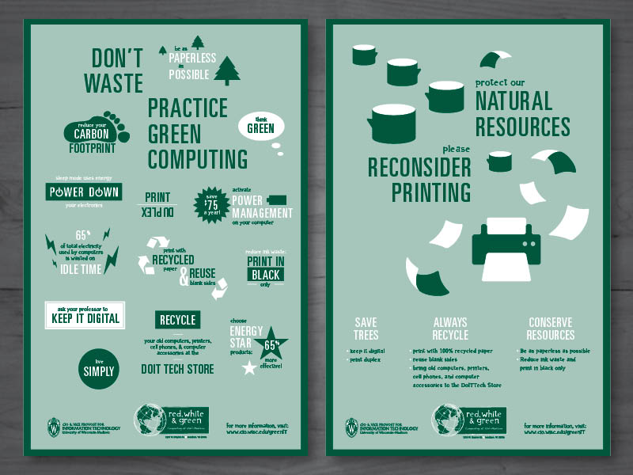
Information Systems, Tenth Edition

Slide 41
Summary
Computer hardware:
Memories:
Multicore microprocessor:
Computer systems categories:
CPU processing speed:
Green computing:
Information Systems, Tenth Edition

